Slide 1

2e sprint review
Groep: Brayden Bos, Bram de Vries, Jah Sanches

Slide 2
inleiding
Unity
Blender
Teamwork

Slide 3

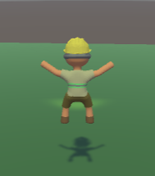
Unity
New Camera System
Animation

Slide 4

Blender
TEX
MAT
Animations

Slide 5
Teamwork
Goed
Slecht

Slide 6





Vragen

